Slide 1


Library management SYSTEM
GUIDED BY:
PRESENTED BY:
Sima gupta
Chaitali Karale
Vaishnavi dungawat

Slide 2
ABSTRACT
1)A library Management System tries to create a computerised version for a library so that the daily work of a library can be managed and monitored easily and efficiently. Earlier, the librarian used to manage the whole work in manual mode in the form of files and record books.
2) Also, the process of adding new books, new students, issuing and returning books had to be managed in a manual manner which is very slow and inefficient.
3) The library management system resolves this problem and provide a better solution to this. It provides a user-friendly interface application to the librarian where he/she can do all the operations of a library very easily.

Slide 3
CONTENT
INTRODUCTION
PROBLEM STATEMENT
ER DIAGRAM
TECHNOLOGY TOOLS
EXISTING SYSTEM
BENEFITS
REFERENCES

Slide 4
INTRODUCTION
1)Traditionally, the librarian managed the whole work in a manual mode or recording the work details in a record book. He/she has to manage all the work related to library such as issuing books to the students, returning books from the students, maintaining all the details of the books, adding new students, new books etc. on a daily basis.
2) But with the increase in the number of user/students and number of books in a library, this management process has become slow and complex. So, a better management of the library work is required.
3)The Library Management System is much more user-friendly, faster in operation and easy to manage than the manual one. Through the use of it, the librarian can manage the whole data of the library in a single database in different tables with a much more security than the traditional way.

Slide 5
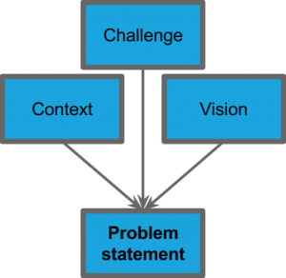
PROBLEM STATEMENT
Since the traditional system i.e the manual system has many drawbacks such as time consuming and there are chances of human error in that process as well.
Library management system saves the information in a database,and this makes it an easies way to perform all the operations efficiently

Slide 6
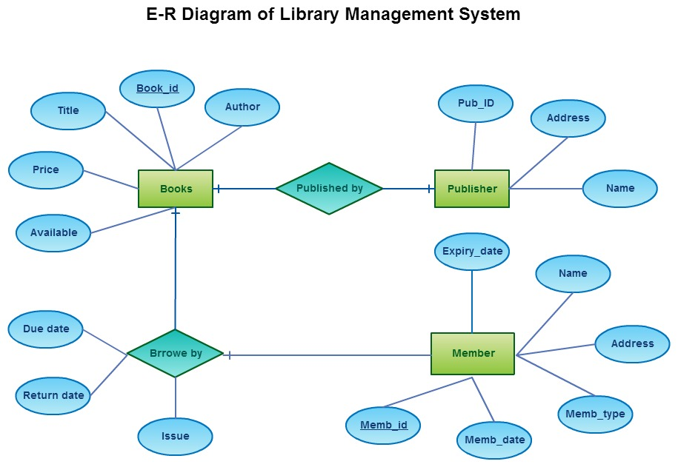
ER DIAGRAM

Slide 7
TECHNOLOGY TOOLS
Software used:
Hardware used:

Slide 8

EXISTING SYSTEM
The existing system is the ‘Traditional library’in which is completely manual run system.
The burden of controlling the library entirely lies in the shoulder of the admin
Moreover the term ‘user friendly’ doesn’t have a place to stand in the existing library system,as the user have the heavy work of finding a desired book from the library
It is very difficult to main the data .

Slide 9
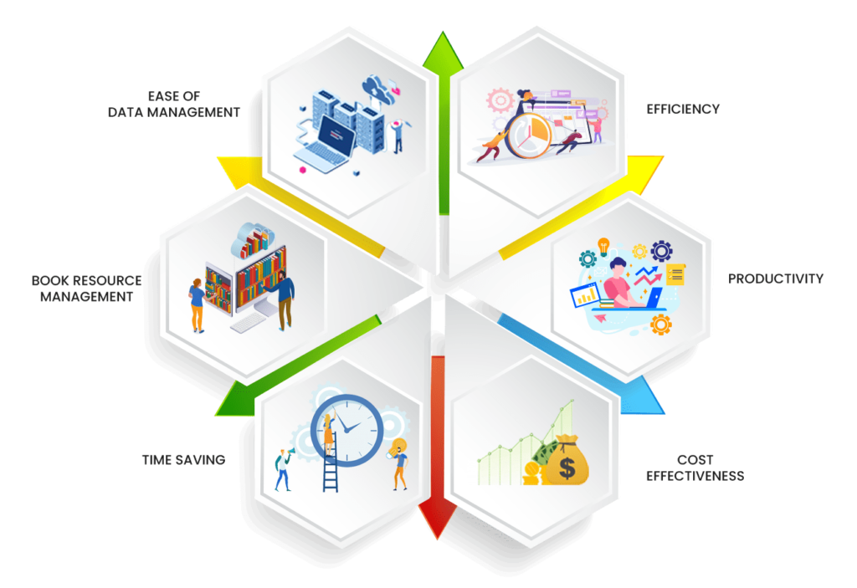
Benefits
1) Quick and easy to use.
2)Saves time and is more efficient than the existing system
3)Inexpensive
4)There would be safe storage of information of member in the database.
5) Userfriendly.

Slide 10


REFRENCES
Software requirement specifications from Google

Slide 11
THANK YOU

